Slide 1
India Inflation Forecasting Using Time Series
A Data-Driven Approach to Inflation Forecasting
$
Ishita Pandey
April, 2026

Slide 2
Table of contents
01
04
02
05
03
06
Objective
EDA
Data Collection &
Description
Model Evaluation
Data Preparation
Conclusion & Insights

Slide 3

Objective:
To analyze and forecast inflation in India using time series models by splitting the dataset into training and testing sets and evaluating predictive accuracy on the most recent observations.

Slide 4
Data Description:
The dataset captures monthly inflation trends in India using CPI for both rural and urban sectors.
Source: Reserve Bank of India (Database on Indian Economy)
Time Period: January 2013 – December 2025
Frequency: Monthly
Type of Data: Consumer Price Index (CPI) – Combined (All India)
Base Year: 2012 = 100
Variables: CPI General Index ,Inflation Rate (%) (Year-on-Year)

Slide 5
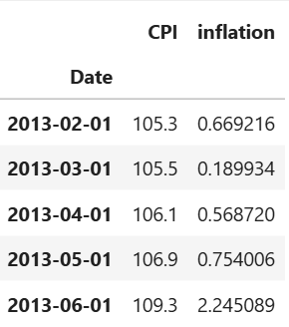
Data Preparation & Transformation:
Converted date column into datetime format
Set date as index and sorted data chronologically
Calculated inflation as percentage change in CPI
Removed missing values after transformation
Prepared dataset for time series analysis

Slide 6
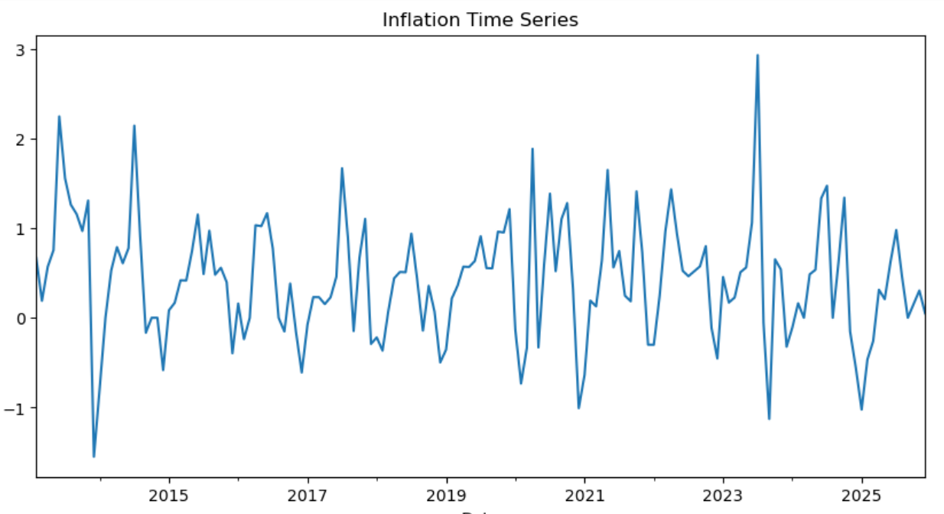
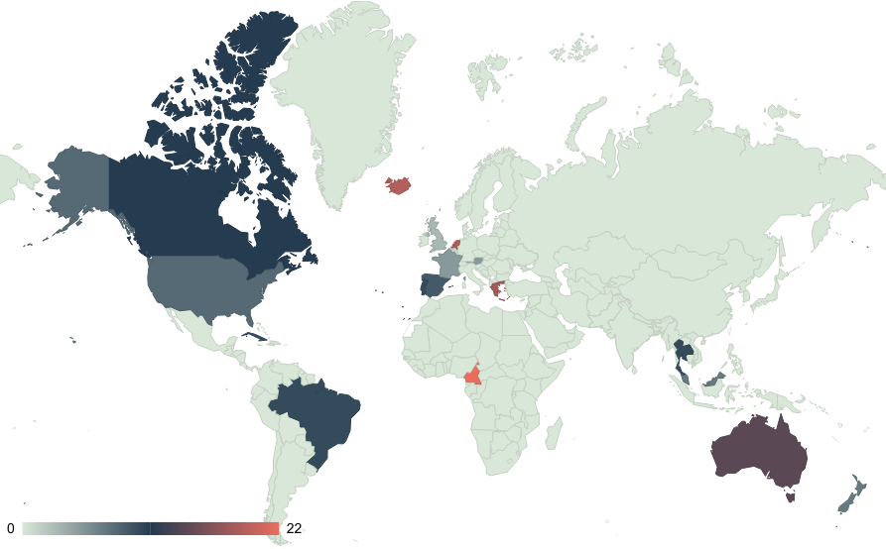
Exploratory Data Analysis:
Inflation exhibits significant fluctuations over time
Presence of short-term volatility
No clear long-term upward or downward trend
Occasional sharp spikes in inflation levels
Indicates dynamic and unstable inflation behavior

Slide 7
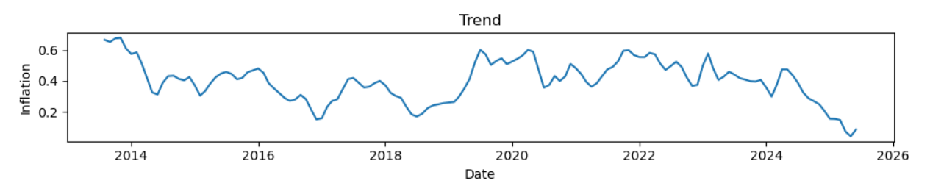
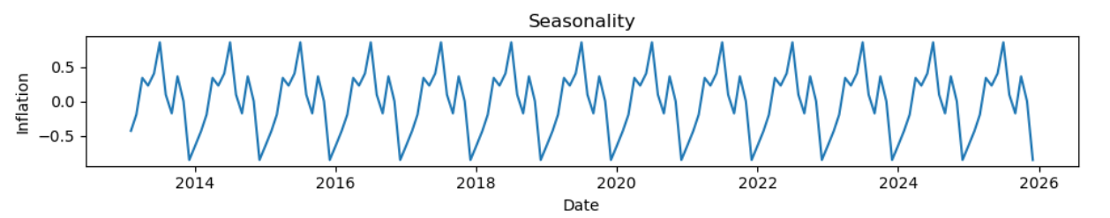
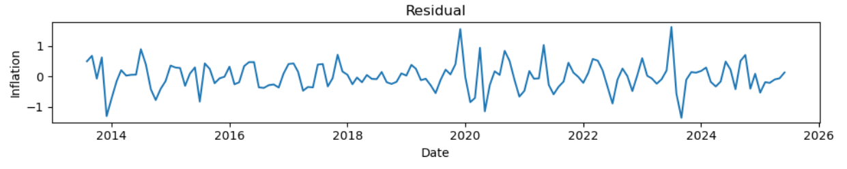
Seasonal Decomposition
Trend: Shows the underlying long-term movement in inflation. It highlights gradual increases and decreases, indicating the overall direction over time.
Seasonality: Captures repeating patterns in inflation at regular intervals. It reflects periodic fluctuations, suggesting consistent seasonal behavior.
Residual: Represents irregular and unpredictable variations. It captures random noise and external shocks not explained by trend or seasonality.

Slide 8
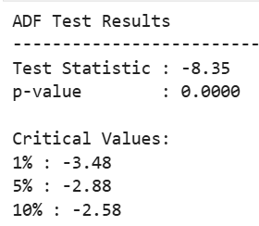
Stationarity Test(ADF Test)
The Augmented Dickey-Fuller (ADF) test was conducted to check for stationarity in the inflation series. The test statistic (-8.35) and p-value (0.0000) indicate strong evidence against the presence of a unit root. Since the test statistic is lower than all critical values, the series is confirmed to be stationary, and no differencing is required for further modeling.

Slide 9
Train-Test Split(Data Partitioning)
The dataset was divided into training and testing sets to evaluate model performance.
80% of the data was used for training the model.
The remaining 20% was reserved for testing and validation.
The split was done in a chronological order to preserve time series structure.
This approach ensures that the model is tested on unseen future data.

Slide 10
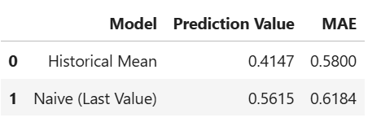
Baseline Models & Performance Comparison
Model Overview
Historical Mean → predicts using average of past values
Naïve Model → predicts using last observed value
Performance Comparison
MAE (Mean Model):0.58
MAE (Naïve Model): 0.62
Best Model: Historical Mean
Model with lower MAE performs better

Slide 11
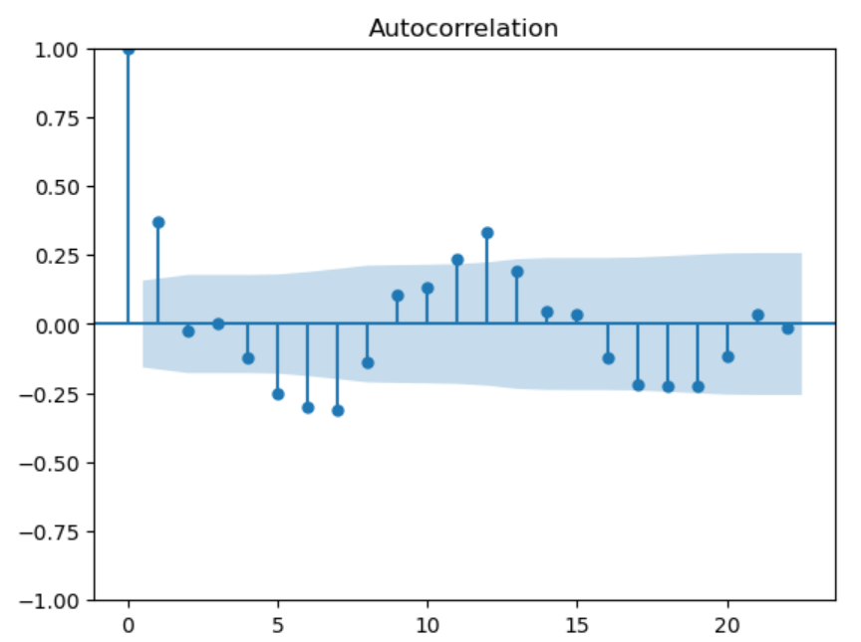
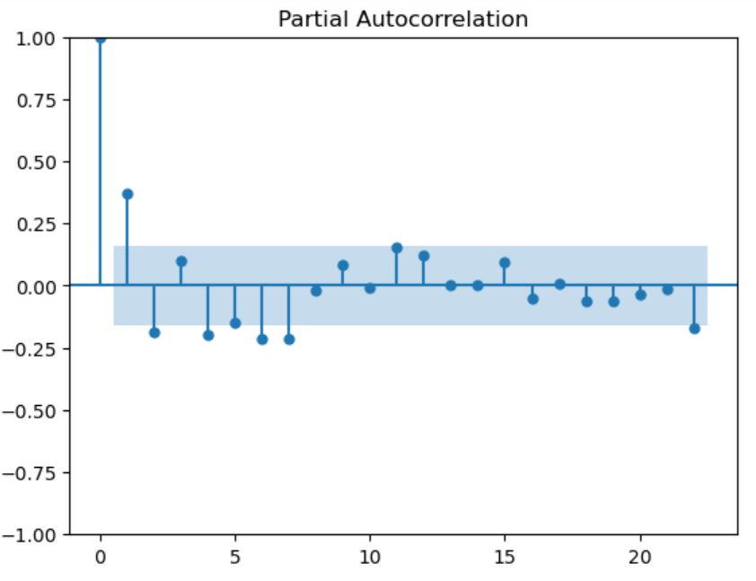
Lag Order Selection(ACF & PACF Analysis)
While the ACF and PACF plots initially suggest a lower-order model such as (1, 0, 1), further evaluation using multiple model specifications shows that (2, 0, 2) yields a lower AIC value. Therefore, (2, 0, 2) is selected as the final model as it provides a better balance between model fit and efficiency.

Slide 12
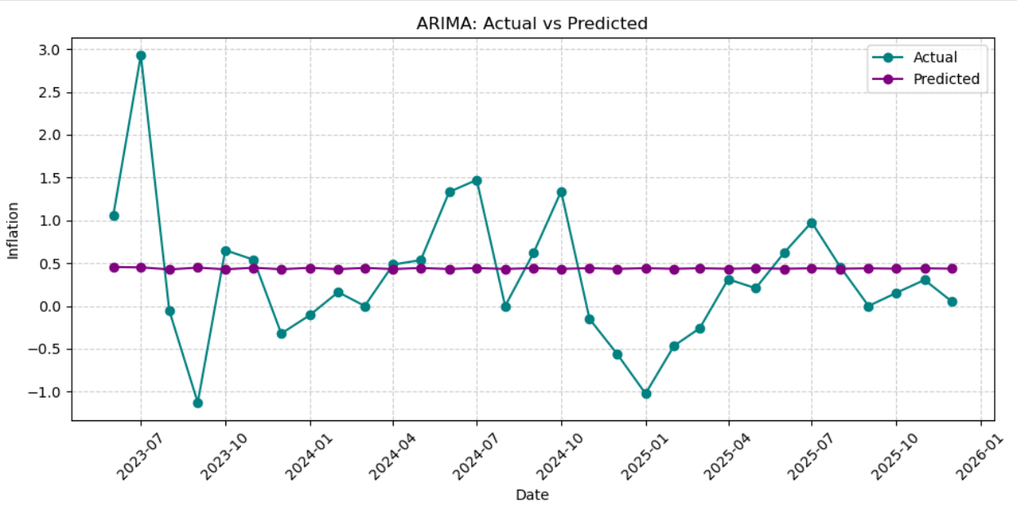
ARIMA Model Forecasting(ARIMA 2,0,2)
ARIMA(2,0,2) selected based on ACF, PACF, and AIC.
Data split into 80% train / 20% test; forecasts generated for June 2023 – December 2025.
Predictions remain relatively stable, while actual values fluctuate, indicating smoothing of short-term variations.
MAE = 0.58, suggesting that the model’s predictions deviate from actual inflation by approximately 0.58 units on average.
Key Insight: Captures overall trend but fails to capture short-term volatility.

Slide 13
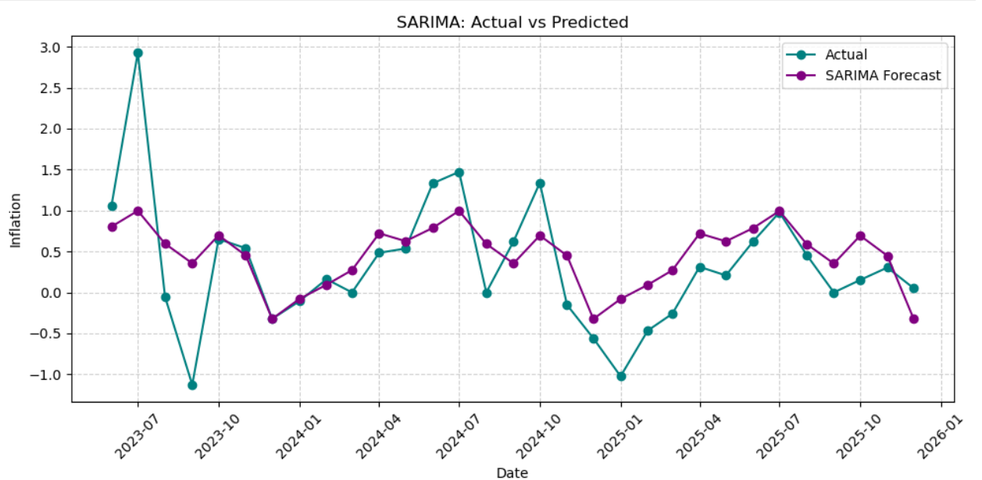
SARIMA Model Forecasting(2,0,2)(1,0,1,12)
SARIMA(2,0,2)(1,0,1,12) selected to capture both trend and seasonality.
Data split into 80% train / 20% test; forecasts for June 2023 – December 2025.
Predictions closely follow actual values, capturing both fluctuations and seasonal patterns.
MAE = 0.42, implying an average prediction error of 0.42 units, indicating improved accuracy.
Key Insight: SARIMA captures both trend and seasonality, improving accuracy over ARIMA.

Slide 14
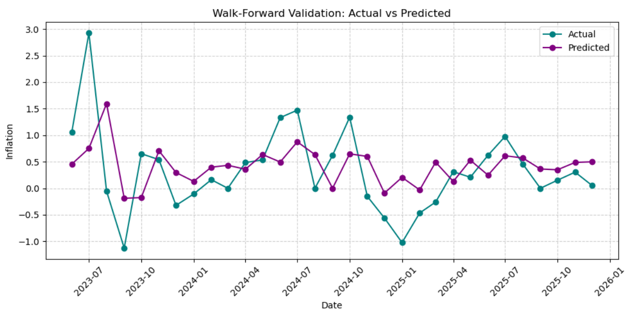
Walk-Forward Validation(Rolling Forecast)
ARIMA (2,0,2) used with walk-forward validation
Training starts with 80% data; predictions generated step-by-step from Jun 2023 to Dec 2025
Model is re-fitted after each new observation for updated predictions
Predictions closely follow actual values and adapt better to fluctuations
MAE ≈ 0.57, on average, predictions deviate by ~0.57 units
Key Insight: Performs well as it continuously updates with new data, improving accuracy

Slide 15
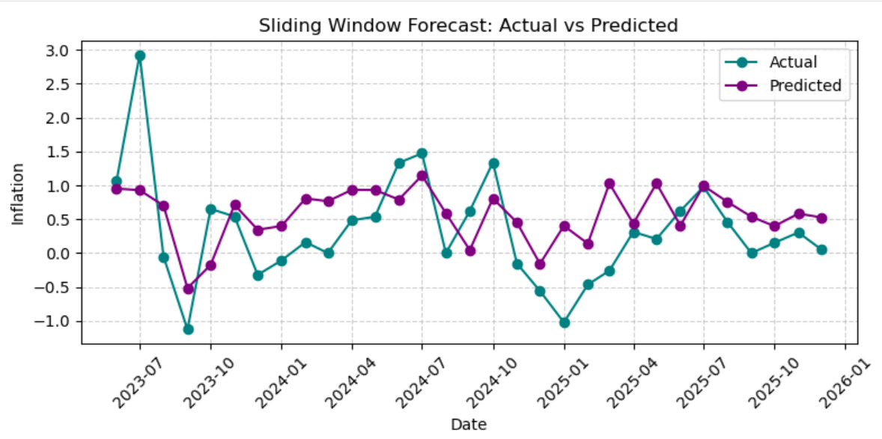
Sliding Window Forecast
The ARIMA (2,0,2) model is implemented using a sliding window approach.
A fixed window size of 50 observations is used, and forecasts are generated from June 2023 to December 2025.
At each step, the oldest observation is removed and the newest observation is added to update the model.
The predictions follow the overall trend and respond effectively to recent changes in inflation.
MAE ≈ 0.57 indicates that the model’s predictions deviate by about 0.57 units on average.
Key Insight: improves responsiveness by focusing on recent data, but may overlook long-term patterns.

Slide 16
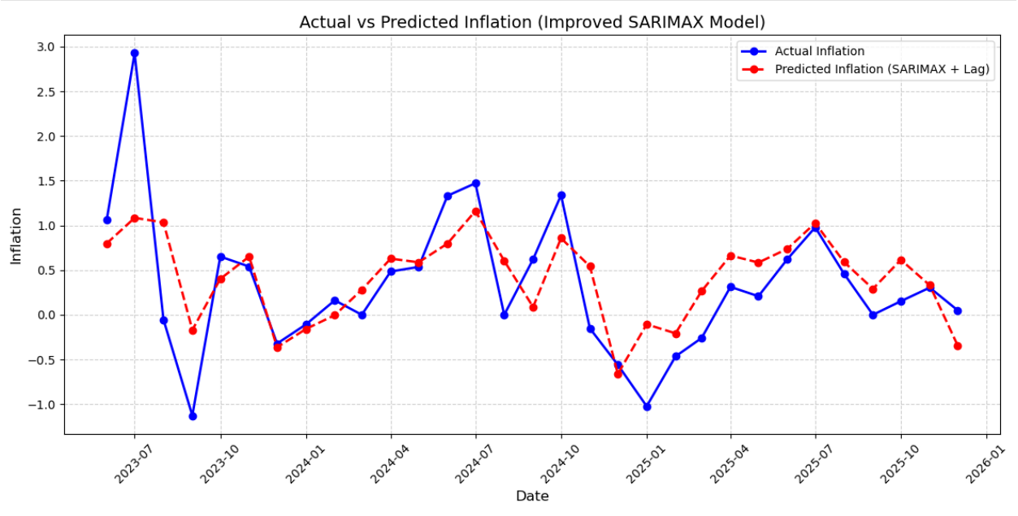
SARIMAX with Lagged Inflation
The SARIMAX model is implemented using lagged inflation as external predictors.
Lag variables (lag1 and lag2) are created to capture past inflation effects.
The data is split into 80% training and 20% testing, and forecasts are generated from June 2023 to December 2025.
It captures both trend and short-term fluctuations, as seen from the close alignment between actual and predicted values.
MAE ≈ 0.40,indicates that predictions deviate by about 0.40 units on average.
Key Insight: The inclusion of lagged variables enhances forecasting accuracy, making SARIMAX the best performing model.

Slide 17
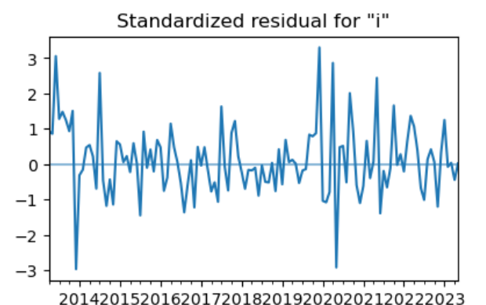
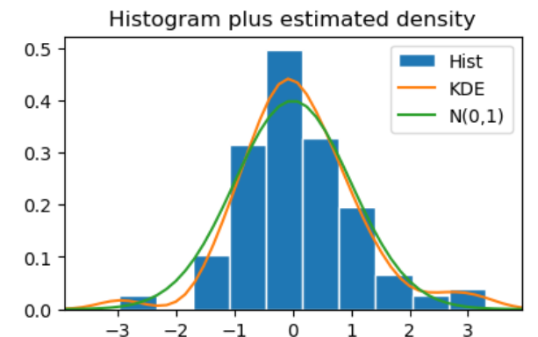
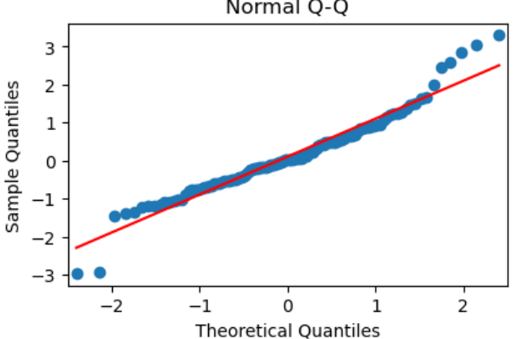
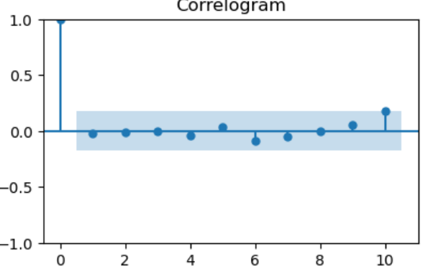
Plot Diagnostics
Residuals fluctuate randomly around zero with no clear pattern, indicating no autocorrelation. Histogram and Q-Q plot suggest approximate normality of residuals. Overall, the model assumptions are satisfied, confirming a good fit.

Slide 18
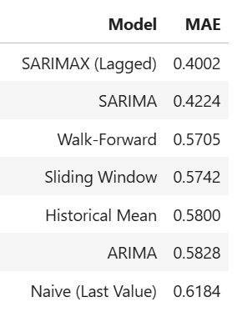
Model Evaluation:
SARIMAX (Lagged) is the best fitted model with the lowest MAE (~0.40).
Lower MAE indicates minimum deviation from actual inflation values.
Inclusion of lagged variables improves forecasting accuracy.
The model effectively captures temporal dynamics of inflation.

Slide 19
Conclusion & Insights:
The SARIMAX model with lagged inflation outperforms all other models, as it records the lowest MAE, indicating the highest forecasting accuracy.
2020–2021: Inflation shows sharp fluctuations due to COVID-19 disruptions.
2022: Inflation rises due to global fuel and commodity shocks.
2023: Inflation begins to stabilize with policy control and supply recovery.
2024: Moderate inflation with seasonal and demand-supply fluctuations.
2025: Inflation remains controlled but slightly dynamic due to rising demand.
2026: Inflation appears relatively stable with minor variations.
Overall, inflation reflects both shocks and stabilization phases, and inflation in India is more shock-driven than trend-driven.

Slide 20
Tools Used:
Python (Pandas, NumPy, Statsmodels, Scikit-learn)
Matplotlib and Seaborn for visualisation
Excel and PowerPoint for final presentation

Slide 21
Thank you!
Ishita Pandey
pandeyishita021@gmail.com
8900571146

